Slide 1
Using Large Language Models (LLMs) with FHIR – Concepts, Use Cases & Foundations
Patrick W. Jamieson, M.D.
Technical Product Manager
Russ Leftwich, M.D.
Senior Clinical Advisor, Interoperability

Slide 2
Learning Objectives
Understand the important of LLMs in Healthcare
Understand core components of LLMs
Learn how to run LLMs locally with LM Studio to perform patient summarization using FHIR
Recognize the practical trade-offs between local and hosted models
Grasp foundational skills in prompt engineering
Explore other real-world use cases combining LLMs with FHIR

Slide 3
What is an LLM?
“A large language model is a type of deep learning model trained on vast amounts of text data using transformer architectures, with the goal of predicting and generating human-like text based on input sequences.”
Adapted from works by Vaswani et al. (2017), Brown et al. (2020, GPT-3), and Bommasani et al. (2021, Stanford Foundation Models paper).

Slide 4
Key Components in This Definition
Large: Refers to the scale of the model—billions of parameters trained on internet-scale corpora.
Language Model: Predicts the next token in a sequence (the core objective in training).
Transformer-based: Built on the transformer architecture from Vaswani et al., 2017.
Human-like text: These models can generate, summarize, translate, and answer in natural language.

Slide 5
Real World Use Cases of LLMs in Healthcare
Problem: Clinicians face information overload and decision fatigue.
LLM Solution:
Mayo Clinic and others use LLMs to summarize patient records to assist diagnostic decision-making.
LLMs generate condition overviews or risk factor highlights for complex patients.

Slide 6
Real World Use Cases of LLMs in Healthcare
Problem: Physicians spend too much time on EHR documentation.
LLM Solution:
Ambience Healthcare and Abridge use LLMs to generate SOAP notes from transcripts.
Amazon HealthScribe applies LLMs to transcribe and summarize doctor-patient conversations.
Result: Clinicians reclaim hours per week in reduced charting time.

Slide 7
Real World Use Cases of LLMs in Healthcare
Problem: Manually querying EHRs for complex patient populations is slow and error-prone.
LLM Solution:
LLMs interpret natural language queries like:
“Find all diabetic patients with HbA1c > 8 and a history of neuropathy”
This is translated into SQL or FHIR queries using prompt-based reasoning or vector search.
Used by AI platforms like LynxMD and Hippocratic AI.

Slide 8
Real World Use Cases of LLMs in Healthcare
Problem: Literature is vast and grows daily; clinicians can't keep up.
LLM Solution:
Tools like BioGPT and PubMed GPT summarize or extract insights from research papers.
Pharma researchers use LLMs to answer questions like:
“What are current treatments targeting IL-6 pathways?”

Slide 9
Real World Use Cases of LLMs in Healthcare
Problem: Patients need reliable health information but access is limited.
LLM Solution:
Ada Health, Babylon, and others use LLMs for symptom checking and triage.
Chatbots provide context-aware guidance for medication adherence, side effect concerns, and appointment prep.
Ongoing research into using LLMs like MedPaLM for high-stakes medical Q&A.

Slide 10
Real World Use Cases of LLMs in Healthcare
Problem: EHR data is locked in free-text clinical notes.
LLM Solution:
LLMs extract medications, conditions, labs, and timelines from narrative reports.
Transforms notes into FHIR-compliant resources for downstream use.
Supports clinical trials, registry reporting, and quality measures.

Slide 11
Real World Use Cases of LLMs in Healthcare
Problem: Identifying at-risk patients early is critical for intervention.
LLM Solution:
Combine embeddings of longitudinal notes and structured data.
Use LLMs to highlight concerning trends in vitals, language, or past diagnoses.
E.g., early detection of sepsis, suicide risk, or readmission risk.

Slide 12
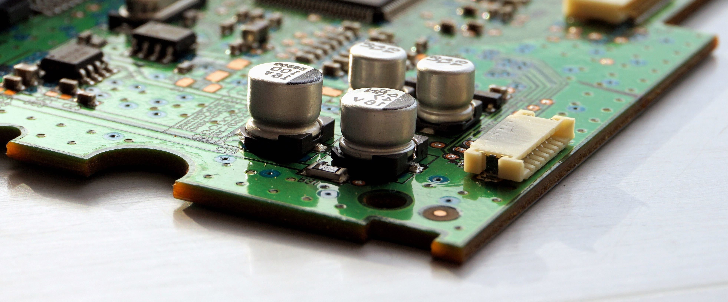
Core Components

Slide 13
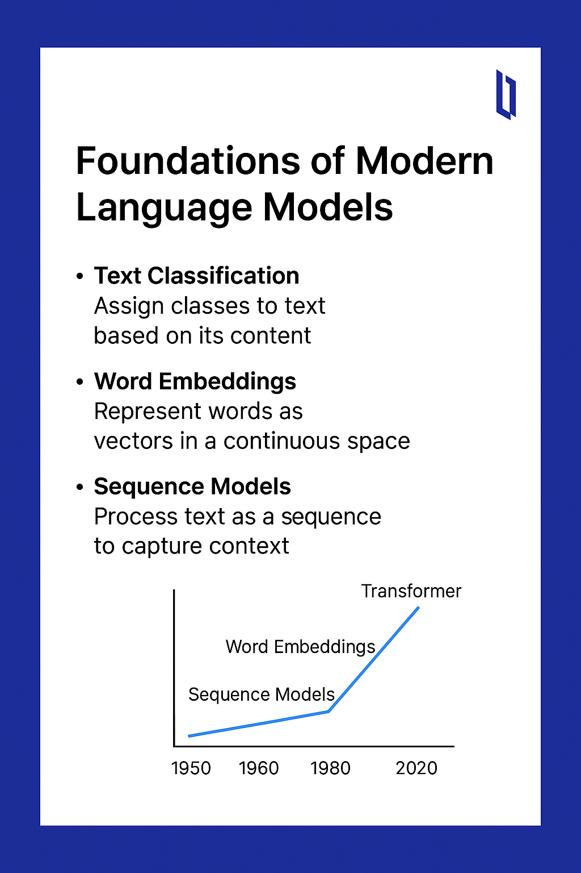
Components Evolved Out of the Evolution of NLP

Slide 14
What Are Word Embeddings?
Word embeddings are vector representations of words.
Words with similar meanings have similar vectors.
Enable models to understand word relationships in numerical form.
Example: 'doctor' and 'nurse' have closer embeddings than 'doctor' and 'car'.

Slide 15
Word2Vec
Introduced by Google in 2013.
Learns word embeddings using shallow neural networks.
Two main approaches:
• CBOW (Continuous Bag of Words)
• Skip-gram

Slide 16
Skip-gram Model (Word2Vec)
Given a word, predict surrounding context words.
Trains model to understand the likelihood of word co-occurrence.
Example:
Input: 'diabetes'
Output: ['chronic', 'condition', 'blood', 'glucose']
Embeddings capture semantic relationships.
Applications in search, recommendation, and classification.

Slide 17
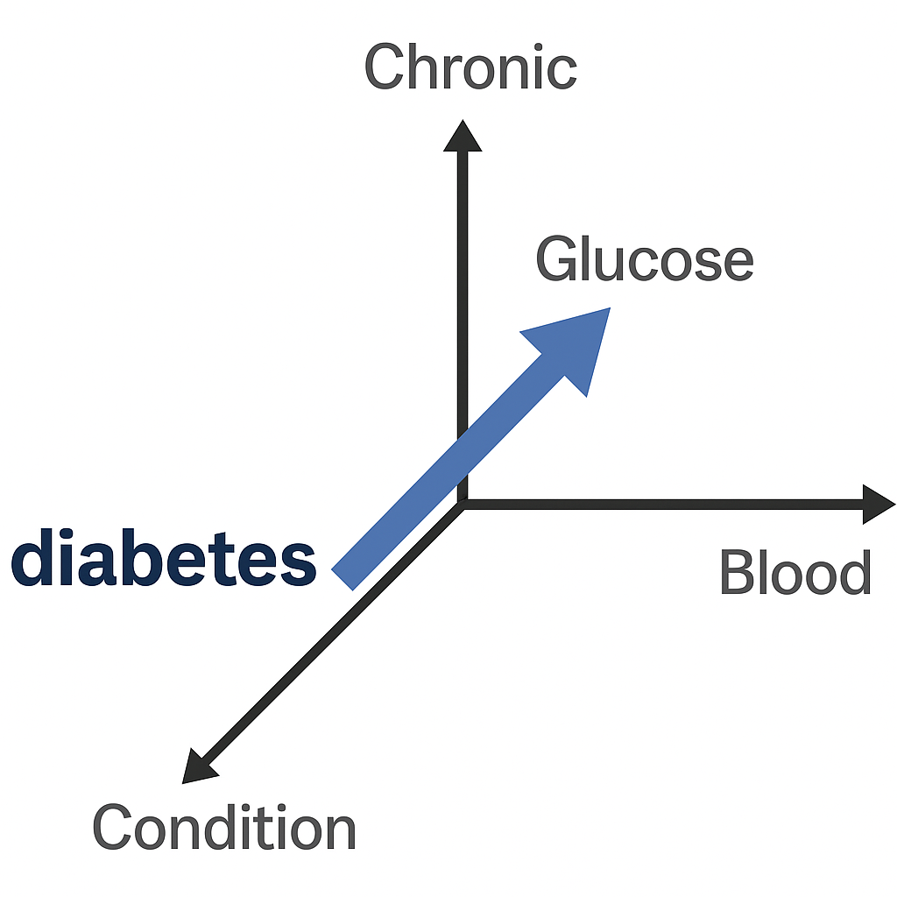

Slide 18

Why Order Matters in Language
Language is sequential: the meaning of a word depends on its context.
Example:
• 'The patient took the medication' vs. 'The medication took the patient'
Sequence models process inputs one token at a time to preserve word order.

Slide 19
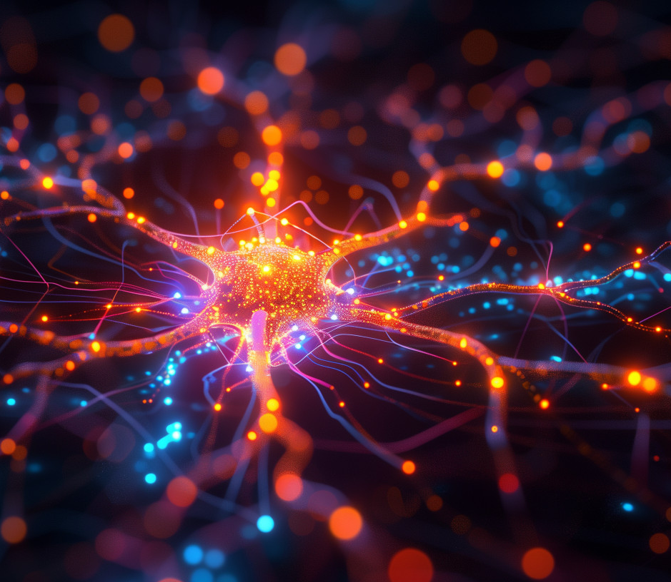
The Importance of Neural Networks in NLP
Neural networks revolutionized natural language processing (NLP).
Enable models to learn from data instead of relying on hand-coded rules.
Capture complex patterns in grammar, semantics, and context.
Support core tasks: translation, summarization, sentiment analysis, Q&A.
Key architectures evolved:
Feedforward Networks → RNNs → LSTMs → Transformers
Foundation for modern LLMs like BERT, GPT, and T5.

Slide 20
What Are Sequence Models?
Sequence models are designed to handle ordered data like text or time series.
They process input in a specific order to capture context.
Examples include Recurrent Neural Networks (RNNs) and Long Short-Term Memory (LSTM) networks.
Foundation for understanding language before transformers.
Notes:
RNNs pass information from one step to the next.
They remember past inputs using 'hidden states'.
Good for short sequences, but struggle with long dependencies.
Example: predicting the next word in 'The patient is feeling...'

Slide 21
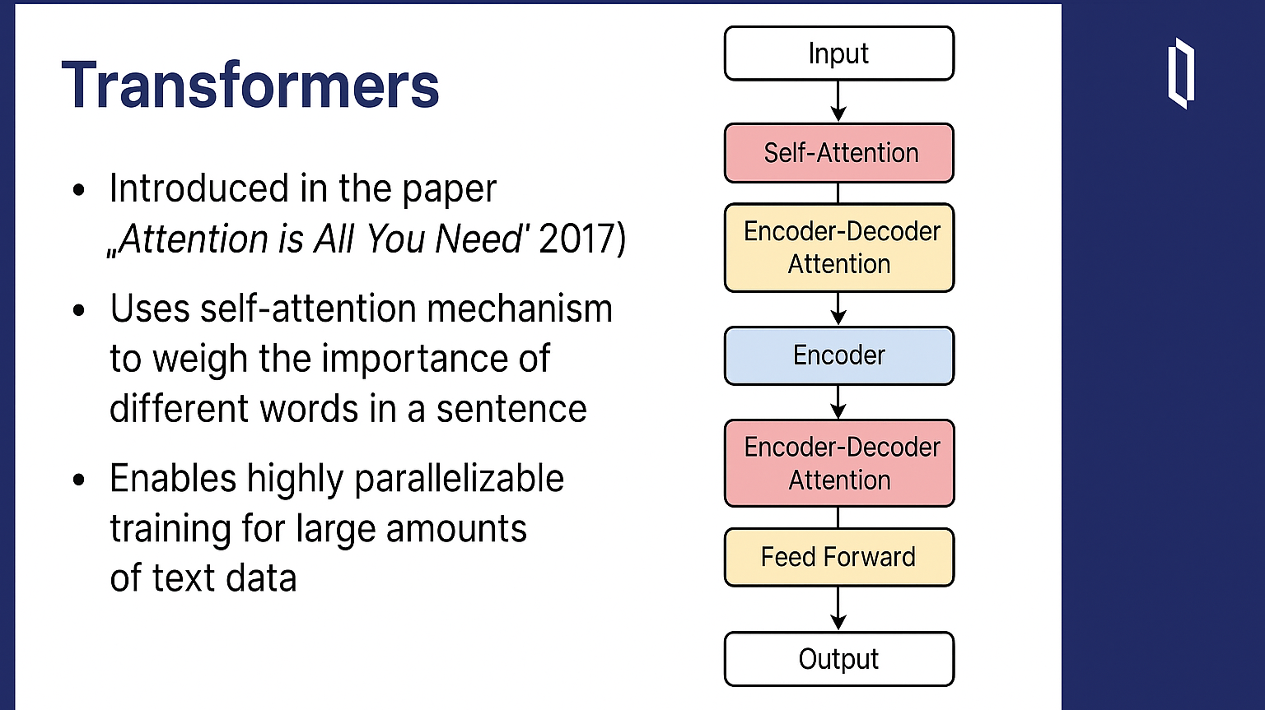

Slide 22
Self-Attention: The Key Idea
Self-attention allows the model to focus on different words in the input.
It assigns weights to words based on relevance to the current word.
Example:
In 'The patient took the medication', attention helps relate 'patient' to 'took'.

Slide 23
Transformer Architecture Overview
Consists of an Encoder and a Decoder
Each block uses:
• Multi-head self-attention
• Feed-forward neural network
• Add & Norm layers
Stacks of layers enable deep context understanding.

Slide 24
Why Transformers Are Powerful
Can process input in parallel — faster than RNNs.
Capture long-range dependencies better.
Scalable: more layers = better performance.
Backbone of models like GPT, BERT, T5, and more.

Slide 25
GPT, BERT, and T5
GPT – Generative Pre-trained Transformer
  Generates text using pre-trained Transformer architecture.
  Example: GPT-4 (OpenAI).
BERT – Bidirectional Encoder Representations from Transformers
  Understands text by analyzing left and right context simultaneously.
  Example: Used in Google Search and medical NLP.
T5 – Text-to-Text Transfer Transformer
  Reformulates all NLP tasks as text-to-text problems.
  Example: Translation, summarization, question answering.

Slide 26
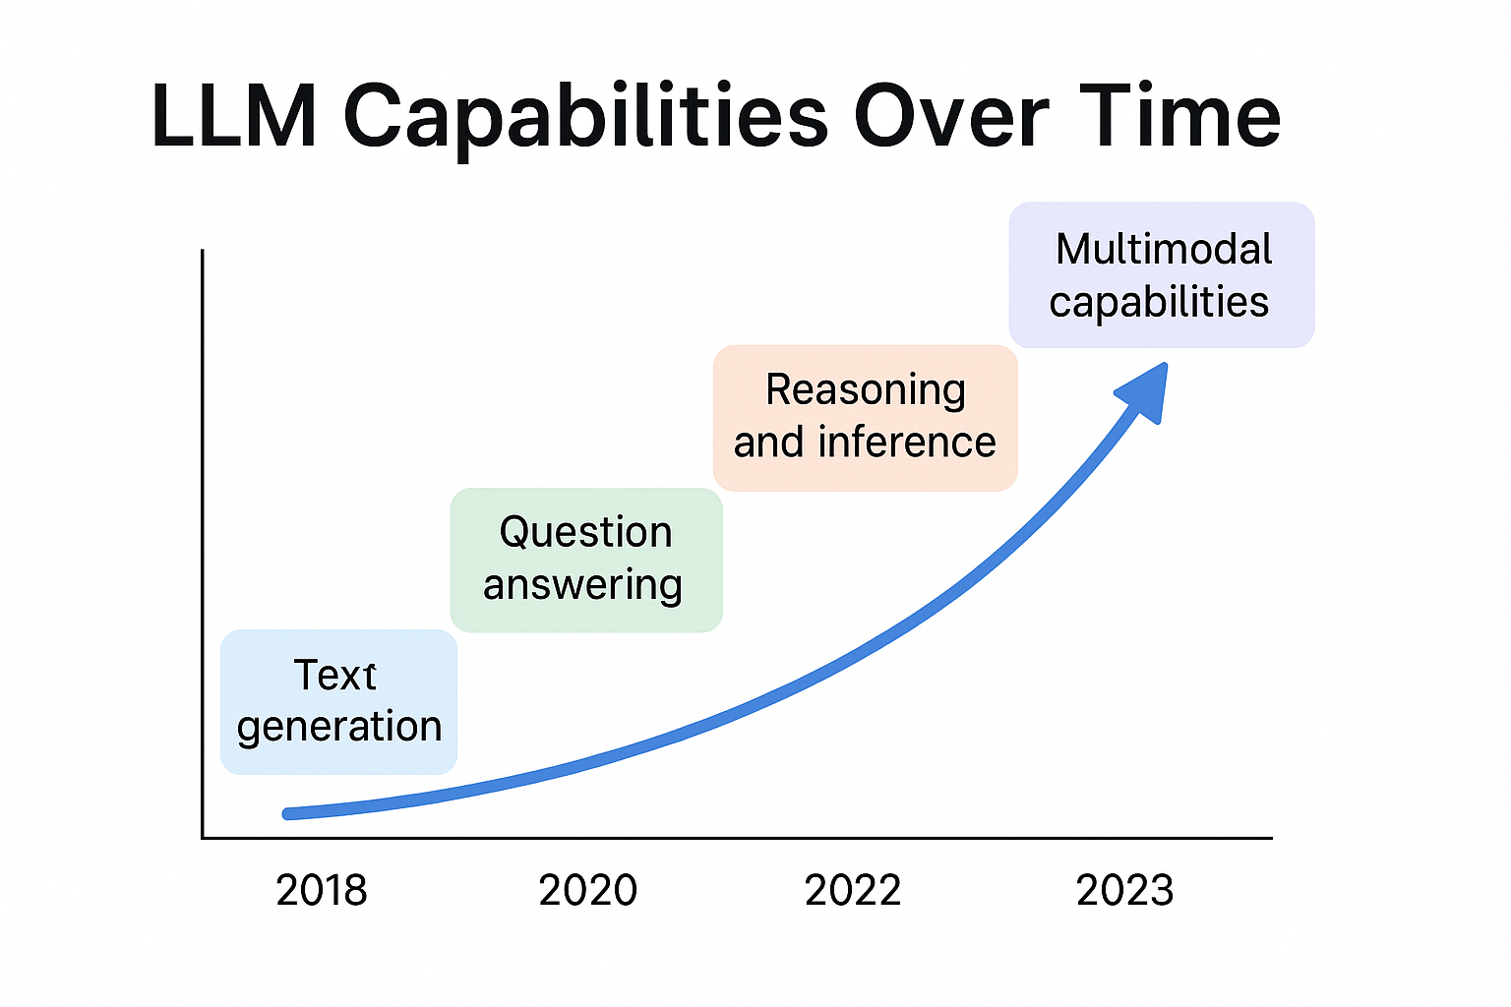

Slide 27
Understanding LLM Hallucinations
LLM "hallucination" refers to when a model confidently generates false, fabricated, or misleading information that appears plausible but is not grounded in real data.
Example in FHIR:
An LLM returns a made-up FHIR query format like
{ "$search": { "last_name": "Smith" } }
— not part of the FHIR standard.
Why It Matters:
In healthcare and standards-based data like FHIR, hallucinations can lead to:
Misleading implementations
Non-compliant systems
Erosion of trust in AI tools

Slide 28
Causes of LLM Hallucinations
1. Predictive Nature:
LLMs generate the most statistically likely next word — not necessarily the correct or true one.
2. Lack of Grounding:
Without real-time access to trusted data sources, responses are based on pretraining patterns, not facts.
3. Training Data Gaps:
If the training set lacks formal documentation (e.g., HL7 FHIR specs), models invent plausible structures.
4. Overgeneralization:
Exposure to various API formats (GraphQL, SQL, etc.) leads to confused synthesis in domain-specific tasks.

Slide 29

Reducing LLM Hallucinations in FHIR Applications
Use Grounding Techniques:
Augment prompts with real documentation (FHIR spec URLs, examples)
Implement Retrieval-Augmented Generation (RAG) Fine-Tune with Domain Data:
Train on curated, validated FHIR queries and responses
Human-in-the-Loop:
Have clinicians or FHIR experts review and approve outputs
Model Choice & Prompt Engineering:
Use smaller, specialized models where possible
Frame prompts with clarity and constraints:
"Return a valid FHIR R4 REST API search query using standard parameters."

Slide 30

Running LLMs on Your Laptop

Slide 31

What is LM Studio?
LM Studio is a desktop app for running local LLMs on your laptop.
Allows you to chat with models like Mistral, LLaMA, or Phi.
No internet required — great for privacy and offline work.
You can also connect to LM Studio from Python using an API.

Slide 32
Using LM Studio: Basic Steps
1. Install LM Studio from https://lmstudio.ai/
2. Launch the app and browse available models (e.g., from HuggingFace).
3. Download a quantized model (GGUF format).
4. Start the local inference server under 'Settings > API Server'.
5. Interact with the model using the built-in chat or via Python.

Slide 33
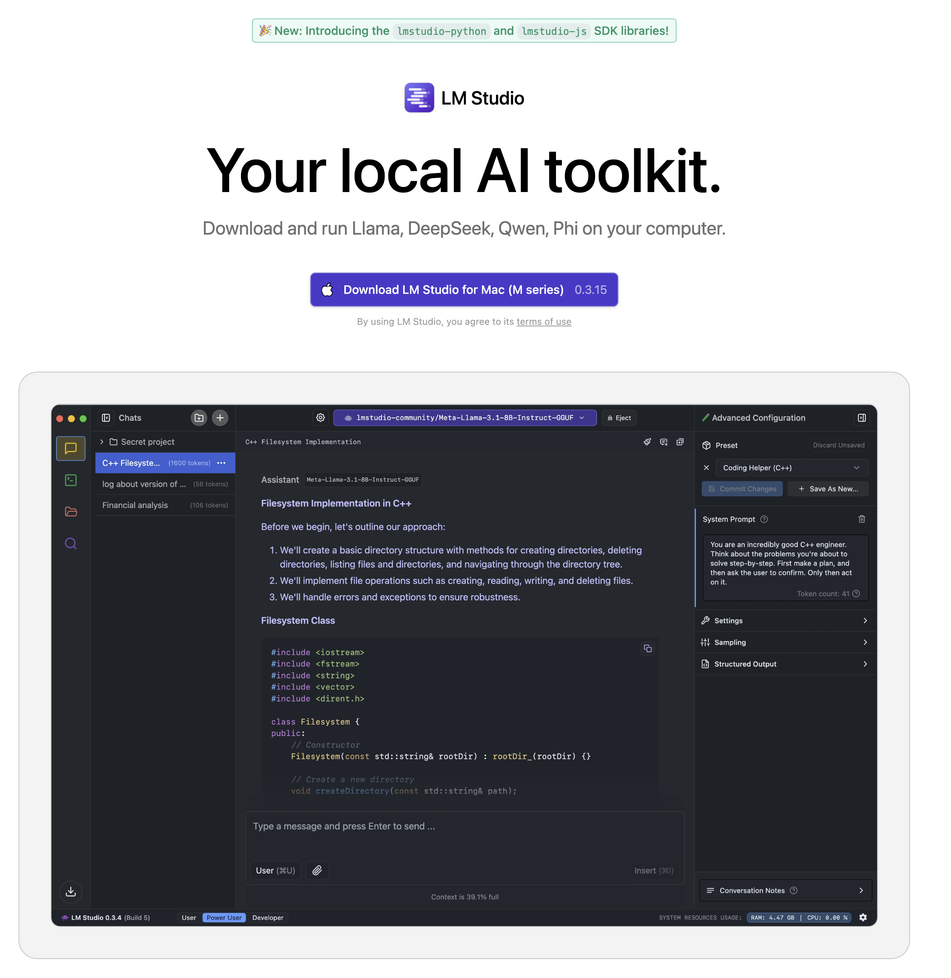

Slide 34
What is Hugging Face?
Hugging Face is a popular platform for sharing and using machine learning models.
Hosts thousands of open-source models (e.g., GPT2, BERT, Mistral).
Supports a wide range of NLP, vision, and audio tasks.
Includes tools like the Transformers library for model loading and inference.
Researchers use it to share pretrained models and datasets.
Developers use it to easily integrate state-of-the-art models into apps.
Hugely important in democratizing access to AI research and tooling.

Slide 35
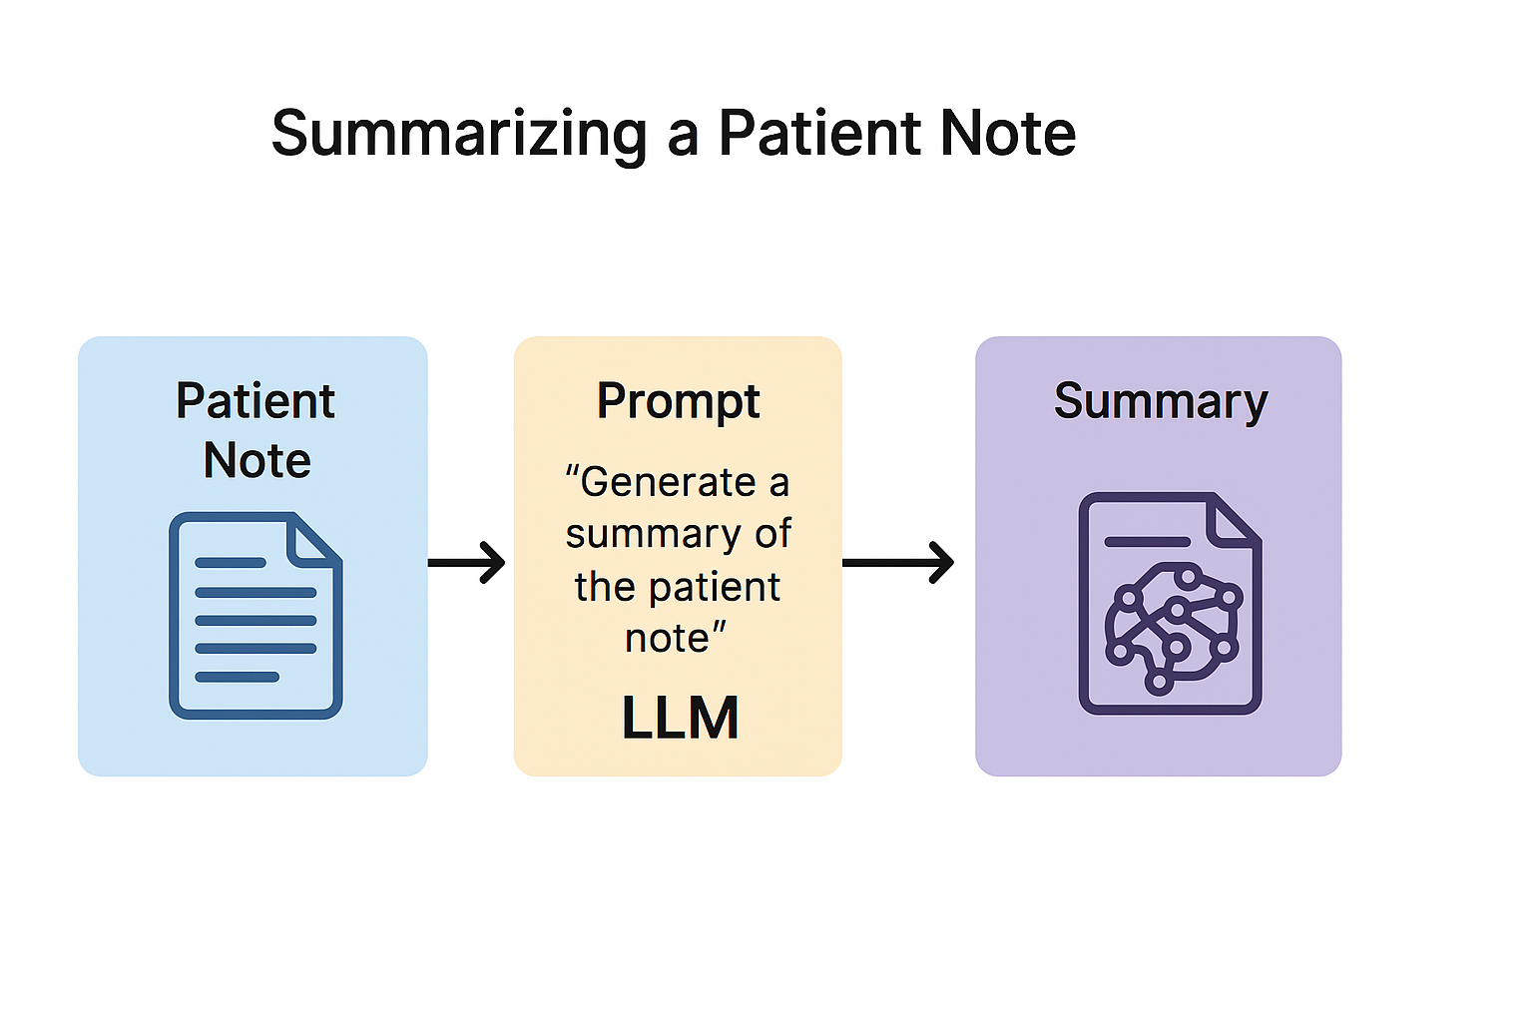

Slide 36
When Are Embeddings Needed for Summarization?
Use Case | Are Embeddings Required? | Why?
Single short note summary | ❌ No | LLM can process raw text directly.
Long note (chunked) summary | ⚠️ Sometimes | Embeddings help find key chunks.
Query-based summarization | ✅ Yes | Used for relevance filtering (RAG-style).
Summarizing multiple notes | ✅ Yes (recommended) | Embeddings organize & rank important content.

Slide 37
What is Patient/$everything?
A FHIR operation that retrieves all resources related to a patient, across resource types.
Enables a comprehensive view of a patient's health history in a single API call.
Returns a Bundle of resources:
Encounter, Observation, MedicationRequest, Condition, AllergyIntolerance, etc.
Read-only operation (does not alter data).

Slide 38
Thank you

